Slide 1

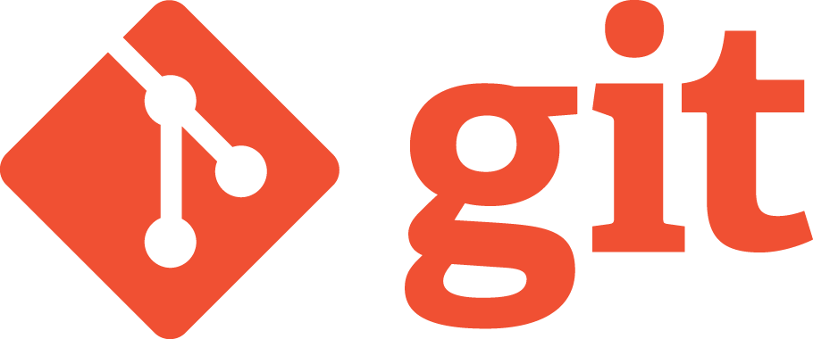

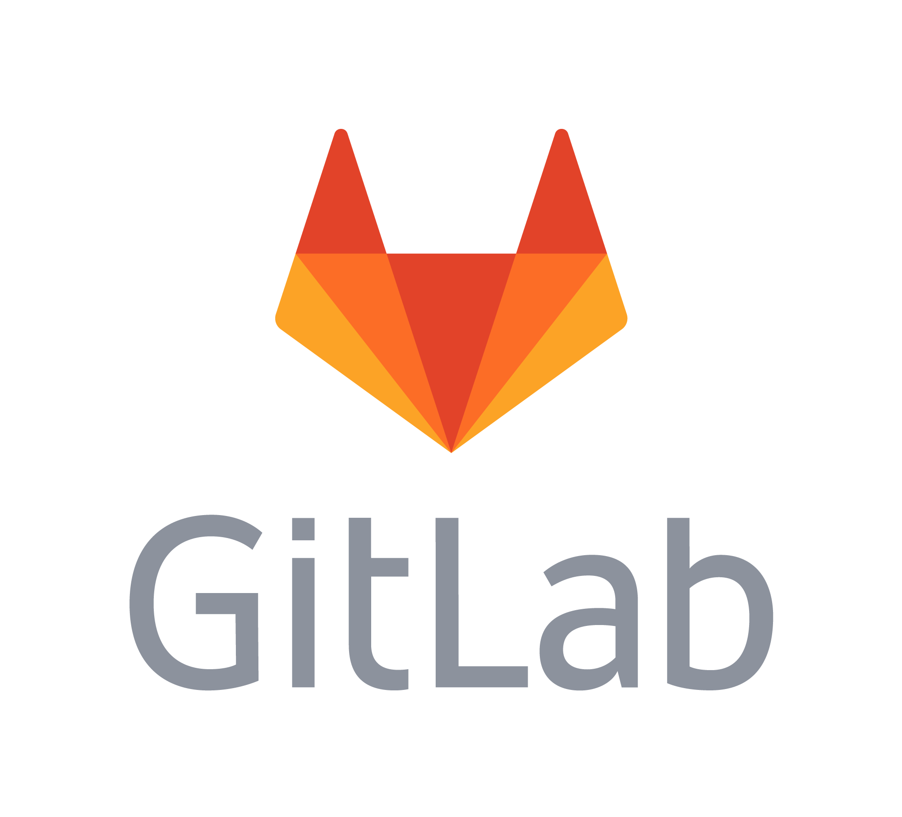

01 – FOSS Communities and Collaboration
Images from:
https://www.atlassian.com/company/news/press-kit
https://about.gitlab.com/press/press-kit/
https://git-scm.com/downloads/logos
https://github.com/logos

Slide 2
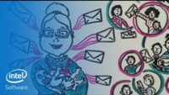
Open Source Basics
https://www.youtube.com/watch?v=upxUAI-fAtE (5:41)
by Sarah Moyle for Intel Software
Notes:
Sarah Moyle – Visual Story Teller
“Introduced innovative facilitation methods inside Intel”
Good metaphor for the processes that FOSS communities use to collaborate,
Give us a big picture to carry around in our minds as we work through some of the details over the next three weeks.
Have them note vocabulary terms as it plays.
- Collect a list on the board
- Have light discussion or clarification of the terms.
Some Key Ones:
- Rules and Roles and Common Language
- Rules -> License
- Roles: Contributor, Maintainer
- Common language:
- Upstreaming
- Also add Upstream (though not in video)
- Branch / Patch
- Main branch
- Fork
“Upstream early and often”
- What does that mean?
- Why do it?

Slide 3
FOSS is Produced by Communities
An open source software community is a group of people united by the shared purpose of developing, maintaining, extending, and promoting a specific body of open source software. These communities are often globally distributed—their members occupy different geographic regions and work across numerous industries. What unites them is their common vision for the open source software project—as well as the spirit of camaraderie and collective identity that participating in the community affords them.
https://www.theopensourceway.org/ the_open_source_way-guidebook2.0.html
Notes:
Discuss in small groups:
ASK: Who makes up the community in the Cookie example?
ASK: What are some challenges that an open source community will face?
- Coordination and Collaboration
- globally distributed
- different regions / languages / time zones
- different industries
ASK: What advantages/opportunities does an open source community afford?
- larger community
- more diverse community
- varied perspectives
- distinct skill sets and expertise

Slide 4
Principles of FOSS Communities
Shared Values
Collaboration
Transparency
Inclusivity
Meritocracy
Release Early & Often
List adapted from: https://opensource.com/open-source-way
Notes:
Discuss in small groups.
- The meaning of these words should be somewhat familiar from everyday use.
- ASK: What do you think they mean in the context of a FOSS community?
- That is what does it mean for a FOSS community to have shared values? Or be inclusive?
- Ask: Why are these good things?
- That is what advantages do they confer in FOSS communities?
The following definitions of the principles are adapted from “The Open Source Way” (https://opensource.com/open-source-way)
Transparency. Whether we're developing software or solving a business problem, we all have access to the information and materials necessary for doing our best work. And when these materials are accessible, we can build upon each other's ideas and discoveries. We can make more effective decisions and understand how decisions affect us.
Collaboration. When we're free to participate, we can enhance each other's work in unanticipated ways. When we can modify what others have shared, we unlock new possibilities. By initiating new projects together, we can solve problems that no one can solve alone. And when we implement open standards, we enable others to contribute in the future.
Release early and often. Rapid prototypes can lead to rapid discoveries. An iterative approach leads to better solutions faster. When you're free to experiment, you can look at problems in new ways and seek answers in new places. You can learn by doing.
Inclusivity and meritocracy. Good ideas can come from anywhere, and the best ideas should win. Only by including diverse perspectives in our conversations can we be certain we've identified the best ideas, and decision-makers continually seek those perspectives. We may not operate by consensus, but successful work determines which projects gather support and effort from the community.
(Shared Values) Community. Communities form when different people unite around a common purpose. Shared values guide decision making, and community goals supersede individual interests and agendas.
Note:
- “Opensource.com is a premier, daily publication focused on open source and Linux tutorials, stories, and resources.”
- “This site is one of the ways in which Red Hat gives something back to the open source community.”
- RedHat – one of the top open source organizations in the world.
- For context, purchased by IBM for $34B
- “In 2020, Opensource.com is read by 2 million people across the globe.”

Slide 5
Roles in FOSS Communities
Users
Leaders
Contributors
Maintainers
Requesters
Notes:
The video identified the roles of:
- Contributor and Maintainer
Larger communities may have a greater diversity of roles.
One way of understanding FOSS communites is to consider the different roles that people take on in these communities. Below are descriptions of some roles that exist. These roles are prototypical and not every one of them roles will exist exactly as described in every FOSS community. Some communities will have slightly different roles, or multiple roles may be combined, etc. In addition, a given individual might simultaneously, or at different times take on multiple roles. So even though they are not exact or universal, understanding these prototypical roles can be helpful in understanding how work happens in FOSS communities.
Users are people who use the software to accomplish tasks. They download and install the software on their machines, or access it via the Web or a cloud based service.
Requestors are typically users that discover bugs, inconveniences, and inefficiencies and report them to the community, or ask for new features that they would find useful.
Contributors: are anyone who makes contributions to the project. Because requestors are contributing bug reports and feature requests they are a type of contributor. Other types of contributors write or improve documentation, perform translations, do user interface design, make code contributions that fix bugs and add features, and lots of other things.
Maintainers: are typically long term contributors who have taken on specific responsibilities within the project. They may work on many of the same types of contributions as contributors but tend to focus on larger more complex tasks that require a deeper understanding of the project. Maintainers often also review contributions from others and have permissions that allow them to merge contributions from others into the upstream project repositories.
Leaders: are typically maintainers who have taken responsibility for managing the project community, guiding the decision making process, making key decisions when consensus cannot be reached, and performing longer-term planning for project.
Discuss in small groups:
- ASK: What might people in each of these roles do in a project?
- ASK: Then these roles from:
a. Most to least project knowledge
b. Most to least responsibility
c. Most to least trusted
d. Smallest to largest group
Compare the ordering and ask what discussions took place.
Use as a chance to distinguish between:
- contributor vs requestor
- leader vs maintainer
As a class:
ASK some of the following as appropriate:
- In the cookie metaphor:
- What role did Grandma Mae have?
- What role did Aunt Maria have when she added chocolate chips?
- What about Uncle Miles when he added nuts?
- What would it mean to be a user?
- What would it mean to be a requestor?
ASK: Which roles would likely have direct write permissions to the upstream project?
ASK: When you first want to add new code to a project what role would you likely have?

Slide 6
Version Control Systems
Version control systems are software tools for:
Maintaining project history
Review
Revert
Facilitating collaboration
main branch / production version
Developers working asynchronously on feature branches
Merging new features into main branch
Notes:
FOSS and more generally all large software projects developed by teams can be complicated to manage.
Some of the things said in the Cookie Video emphasize this:
- “How the potential chaos of all these copies can be transformed into a collaborative whole.”
- “Has potential to be complicated because it is created by communities of people”
- “These ways of working manage those communities making it possible to benefit from new versions from an authoritative source”
- At the end she states that this all “Requires a disciplined way of managing change”
- Need good tool support
- VC is one part of that support.

Slide 7
git and GitHub
Tools for version control and collaboration:
git
CLI version control tool that runs on your computer
maintains repositories (repos)
complete copy of the code / docs
complete history of changes
Can also be integrated into IDE or GUI tool.
gitHub
a cloud service for hosting repositories
facilitates collaboration
Forking/Upstreaming support
Issue tracker
Notes:
Git and GitHub are currently the dominant tools for supporting version control and collaboration in software development.
These two tools work together.
Very broadly:
- Individual developers use git
- to manage their repositories and track code changes.
- Communities use GitHub
- to bring together changes from developers
- to track and communicate needs (e.g. issue tracker)
The line between the two can become a little blurry.
- GitHub also lets you do some things that are really git operations.
- So this is GitHub as a GUI integrating git into its GUI.

Slide 8




Other Options
Version control tools:
CVS, Subversion (SVN), Mercurial
Repository Hosting:
GitLab, BitBucket, SourceForge
Images from: https://www.linuxnix.com/what-are-the-top-version-control-systems/
https://sourceforge.net/p/gmorgan/admin/files/badges
Notes:
Git and GitHub may be dominant now, but lots of other options exist and are being used.
These are just some examples to indicate that there is breadth here.
You may encounter different tools in different projects, communities or companies.
Most will rely on the same set of fundamental concepts.
- While we are learning Git / GitHub specifically
- We will do so in a way that focuses on the larger concepts
- That will hopefully make what you learn more flexible and generalizable

Slide 9
GitHub and git
Terminology
Notes:
We will look conceptually at how GitHub and git work together in open source projects
How contributors make contributions
How maintainers know about them
While we are doing open source here, the same processes are commonly used in proprietary development as well.
Also, we’ll look at GitHub and git, but other tools have similar terminology and workflows.
- The words might just be a little different.
- Once you have the concepts it is pretty easy to move between different tools and platforms.

Slide 10
GitHub and git: Local vs Remote
Local / Your Machine
A personal machine, either physical or remote
Notes:
Local
- A machine under your control
- Physical or remote virtual (in the cloud)
- Used for development
- editor
- browser
- shell
- git
- etc
Remote: things that are in GitHub
- Stored on servers in data centers somewhere out on the internet
- E.g. at GitHub or GitLab, etc…
- You will interact with them through your browser.

Slide 11
GitHub and git: The Upstream
The
Upstream
Repository
Notes:
When you go to join a FOSS community and use or contribute to its project:
- The project code will typically live on one of the repository hosting services (e.g. GitHub)
- The repository that lives on GitHub is the upstream repository
- It is the reference copy of Grandma Mae’s cookie recipe.
ASK: Why does it live on a hosting service?
- Collaboration, transparency, release early & often
ASK: Will you have write permissions to the upstream?
- Nope, at least not until you gain trust and move up to a maintainer role.
- This is going to be an important factor is understanding why GitHub/git work the way that they do.

Slide 12
GitHub and git: Forking the Upstream
The
Upstream
Repository
Notes:
The first step in working with the project is to Fork the Upstream.
- I.e. When you Fork the Upstream, you make your own copy of the main project repo into your GitHub space.
ASK: Why would you need to make a copy?
- To make changes you need write permissions.
- You have full control over this copy.
- Add chocolate chips, add nuts, add coconut, you name it.
ASK: How many forks will there be?
- At least as many as there are developers
This fork:
- is exactly like the upstream (main project) repository
- it knows where the upstream from which it was forked is
- This is represented by the orange arrow from your remote copy to the upstream.
- We will see in a bit that this is what makes it possible to upstream the changes.
- You have full write permission to the contents of this for.
Note: The slightly different meaning of fork here than in the video.
- The video was talking about forking or splitting the community
- I.e. Uncle Miles and his nut lovers go one way, Grandma Mae goes the other.
- You need a copy to do that kind of fork too.
- Here a fork is just a copy of the repository that is made by an individual developer.
- It could be used to fork the community
- But can also be used by an individual developer to upstream changes.

Slide 13
GitHub and git: Cloning your Origin
The
Upstream
Repository
Your
Origin
Repository
Your
Local
Repository
Notes:
The next step is to Clone your fork.
- I.e. When you clone your fork, you make another copy of the repository on your local machine.
- That copy is called your Local repository.
- It is on your local machine, stored on your disk drive.
- The fork from which your local repo is cloned is called your origin repository.
- It is the ”origin” of your local repo.
ASK: Why do this?
- Can open files with your editor
- Can compile and run the code
- Can work without network access (crazy!)
- You also have full write access to this copy.
Note that the local clone knows where the origin from which it was cloned is.
- i.e. it knows where it came from.
- This is represented by the orange arrow from the local repo to the origin repo.
ASK: Why should it know that?
- It is how we will be able to upstream changes!
Note: Things seem to be moving toward being able to do most if not all of that in the cloud
- from within your browser
- running tools and code on a server somewhere else.
- but not quite completely there yet.
- also likely will cost $$ to operate that way.

Slide 14
GitHub and git: Cloning your Origin
The
Upstream
Repository
Your
Origin (Fork)
Repository
Your
Local (Clone)
Repository
Notes:
The next step is to Clone your fork.
- I.e. make another copy of the repository on your local machine.
- That copy is your Local repository.
- It is on your local machine (i.e. in Linux Lite in this class).
- This fork from which your local repo is cloned is called your origin repository.
ASK: Why do this?
- Can open files with your editor
- Can compile and run the code
- Can work without network access (crazy!)
Note that the local clone knows its origin
- i.e. where it came from.
ASK: Why should it know that?
- It is how we will be able to upstream changes!
Note: Things seem to be moving toward being able to do most if not all of that in the cloud
- from within your browser
- running tools and code on a server somewhere else.
- but not quite completely there yet.
- also likely will cost $$ to operate that way.

Slide 15
GitHub and git: Ready to work
The
Upstream
Repository
Your
Origin (Fork)
Repository
Your
Local (Clone)
Repository
Notes:
The state of things when you are ready to work on the project.
- You have forked the main project repo to create your remote copy (i..e the origin)
- You have cloned your origin to create your local repo.
Nex you ou will identify something to do:
- something that you want
- Add chocolate chips or nuts or coconut, go crazy!
- You can do anything you want, its your copy and its FOSS licensed.
- something that the community wants to have done

Slide 16
GitHub and git
Workflow and Upstreaming
Notes:
A “Workflow” is a process that is followed to do work
In this case we are interested in how changes get unstreamed.

Slide 17
Workflow: Make Changes*
Simplified
for now
Notes:
When a developer is working on the code, they will be making changes on their local repo.
- That is they basically open up a code file in their editor, make some changes, save the file.
- This is represented by the change of the words from white to green
- It is just a simple way to indicate that some changes to the code.
I say this is simplified (for now):
- We are going to, for now, neglect some details so that we can understand the workflow.
- We’ll add those details in over the next several classes.
- The main thing we are leaving out is that:
- The code is in a version controlled repository
- So making changes isn’t quite as simple as opening the file, editing, saving.
- Recall that version control maintains a complete history of all changes.
- So ensuring that that history is maintained is one of the things we’ll have to deal with.

Slide 18
Workflow: Push to Origin
Notes:
Now that you have changes that you like…
Maybe you want to upstream them to give them back to the project.
To do that you’ll need to get them to cloud
- So you will need to move those changes to your remote repo – i.e. to your origin
- and eventually move them to the main repo also – the upstream.
The first step is to push the changes to your origin.
- The change to green in the origin reflects your local changes being copied there.
ASK: Why do you think we push to the origin?
- Most importantly, you are not allowed to write to the upstream repo.
- remember only maintainers are allowed to do that.
- The upstream repo cannot see your local copy because it is on your machine.
- You might erase them, or turn your machine off, or move it to some other location…
- So pushing puts your changes into the hosting service
- Then the upstream will be able to find them – once you tell the upstream that they exist!

Slide 19
Workflow: Making a Pull Request
Notes:
Now your changes are in the hosting service
- So now you need to tell the maintainers at the upstream that you have some changes you’d like to contribute.
- You do that by making a Pull request.
- The pull request is essentially a message to the upstream maintainers
- The pull request tells them about the changes you want to contribute.
- Aunt Maria wants to add chocolate chips.
- Uncle Miles wants to add nuts.
- The maintainers and the upstream repo can see your changes because they are also on the hosting service.

Slide 20
Workflow: Merge into Upstream
Notes:
If the project maintainers/leaders like the changes you proposed in your Pull Request
- they merge your proposed changes into the upstream.
- That is they combine your code with the code in the main repo
- e.g. Grandma Mae’s recipe now contains chocolate chips.

Slide 21
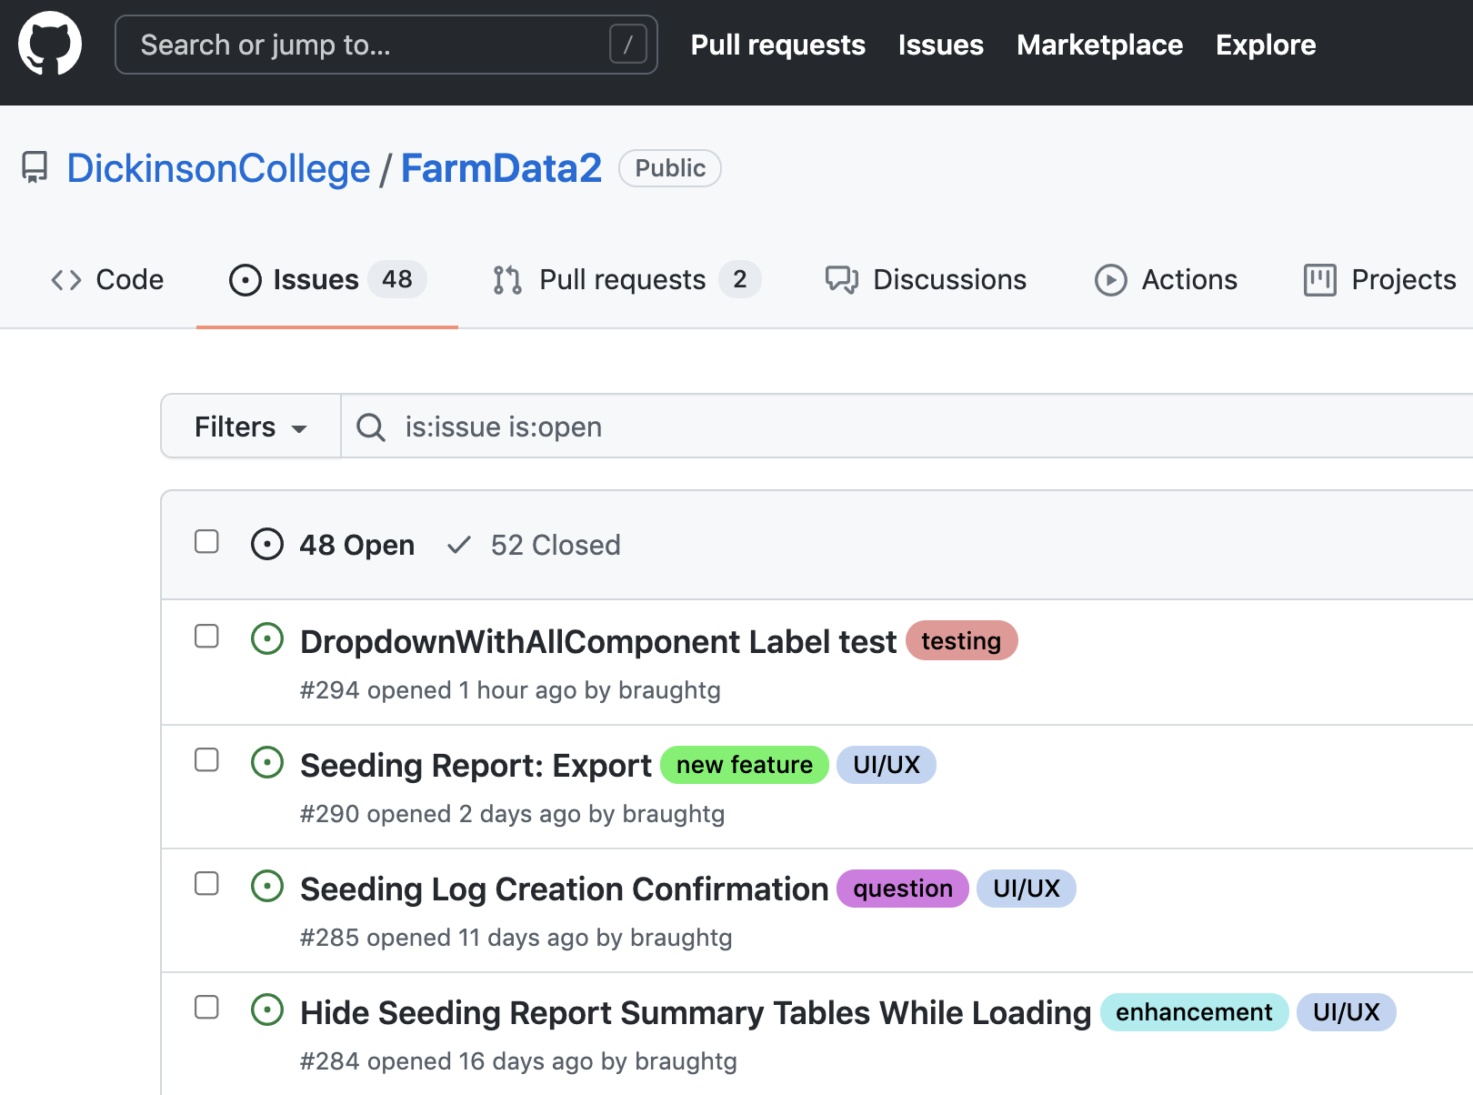
The Issue Tracker
Notes:
The issue tracker contains a list of things that need to be done in the project
- new features to be added
- bugs to be fixed
- features to be enhanced
- testing to be done
- questions to be answered
- etc…
You will get interact with an issue tracker in the Activity

Slide 22

Acknowledgments:
Slide Template From:
https://creativecommons.org/licenses/by/4.0/
Slide Content Licensed as:
https://creativecommons.org/licenses/by-nc/4.0/

